Slide 1
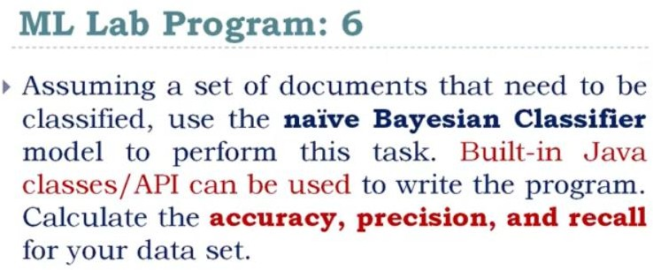

Slide 2
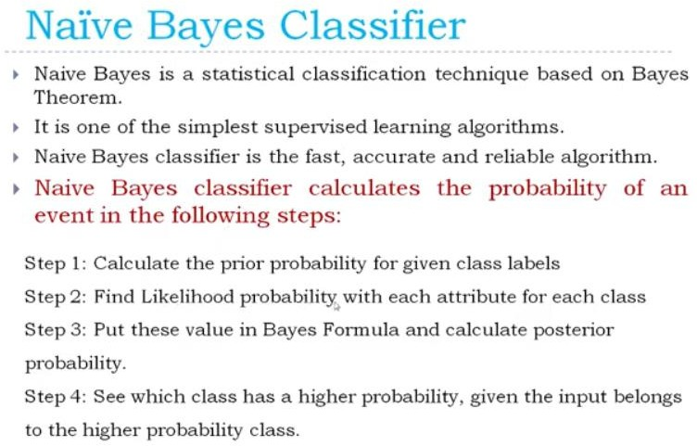

Slide 3
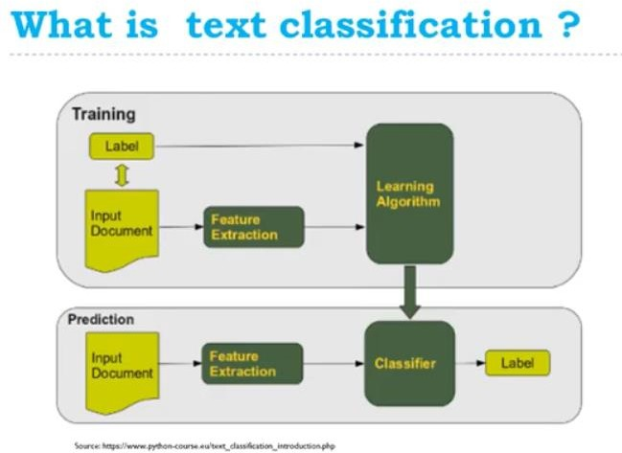

Slide 4
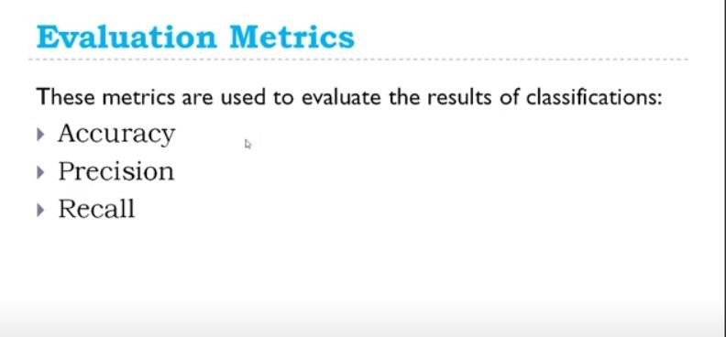

Slide 5
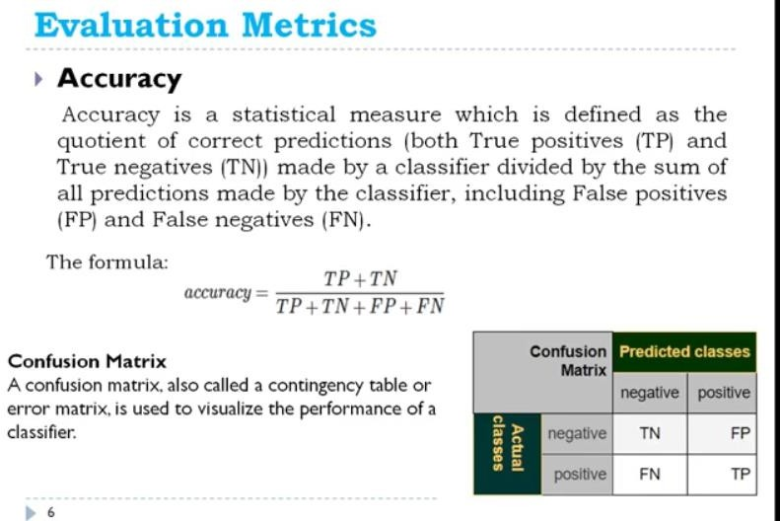

Slide 6
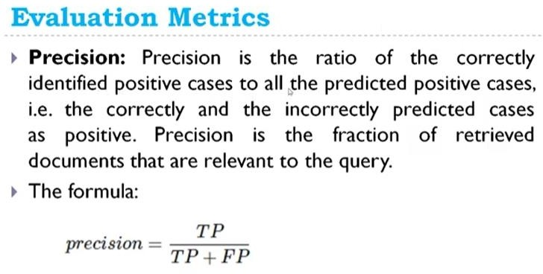

Slide 7
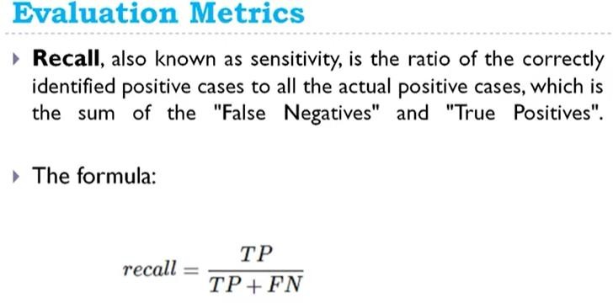

Slide 8
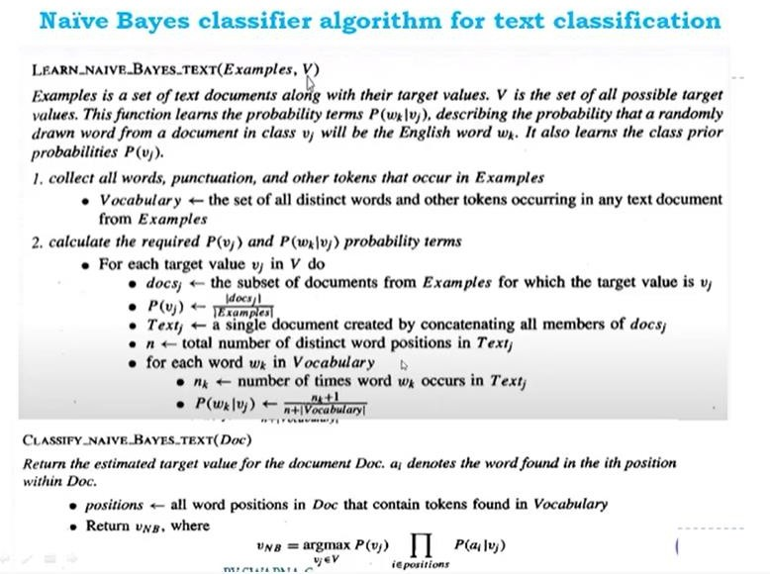

Slide 9
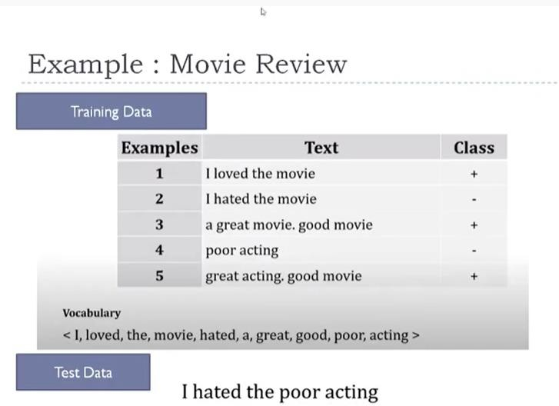

Slide 10
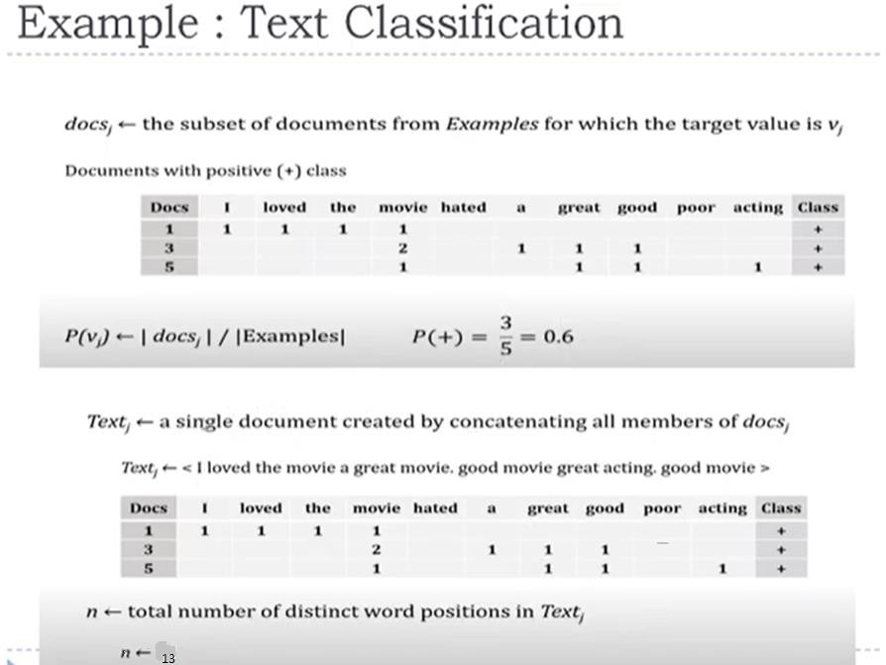

Slide 11

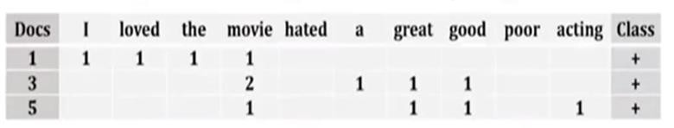
Example 1:Text Classification
For each word in vocabulary
Nk<-no.of times word wk occurs in textj

Slide 12
Calculating all prior probabilities
P(I|+)=(1+1)/(13+10)=0.08695 P(loved|+)=(1+1)/(13+10)=0.08695 P(the|+)=(1+1)/(13+10)=0.08695 P(movie|+)=(4+1)/(13+10)=0.2174 P(hated|+)=(0+1)/(13+10)=0.0435 P(a|+)=(1+1)/(13+10)=0.08695 P(great|+)=(2+1)/(13+10)=0.1304 P(good|+)=(2+1)/(13+10)=0.1304 P(poor|+)=(0+1)/(13+10)=0.0435 P(acting|+)=(1+1)/(13+10)=0.08695

Slide 13
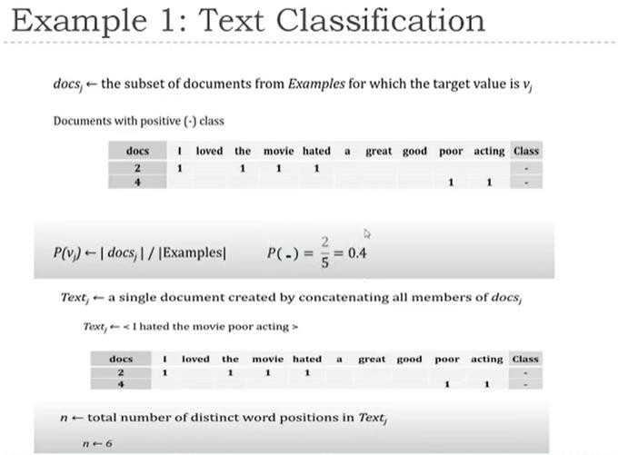

Slide 14
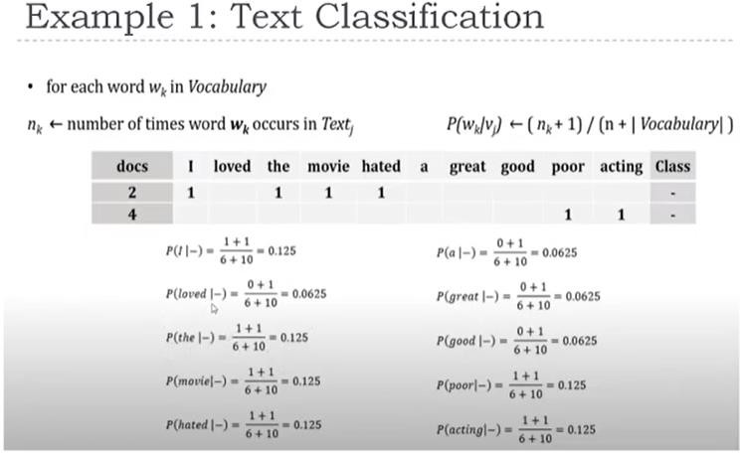

Slide 15
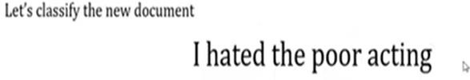
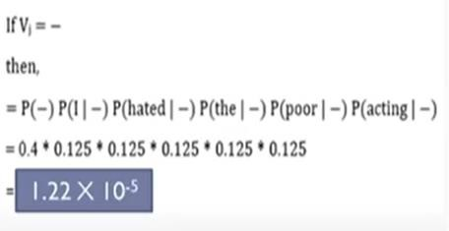
Contd..
•

Slide 16

Contd..
=P(I|+) P(hated|+) P(the|+) P(poor|+) P(acting|+)
=0.08695x0.0435x0.08695x0.0435x0.08695
=1.2439xe⁻⁶
So,it belongs to negative class.

Slide 17
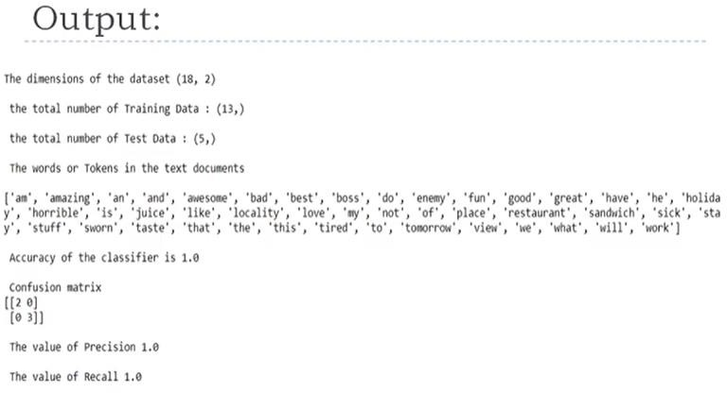

Slide 18
